Slide 1




Planning for the Impacts of Climate Change on North Carolina’s Agricultural Sector
2024 AI BOOTCAMP | PROJECT 3
CONTRIBUTORS: Mike Szumski and Jamie Bond

Slide 2
CONTENTS |  | PAGE
Executive Summary |  | 3
Background |  | 4
Approach |  | 5
Modeling and Analysis |  | 6
Findings and Conclusions |  | 9
Additional Investigation Area |  | 10
Reference Content |  | 15
PROJECT OBJECTIVE
In this project, the University of North Carolina Charlotte / Chapel Hill AI Bootcamp project team examined the impacts of weather events, particularly flooding, on North Carolina agriculture and developed predictions about future impacts of climate change driven events on the state’s agricultural sector.

Slide 3
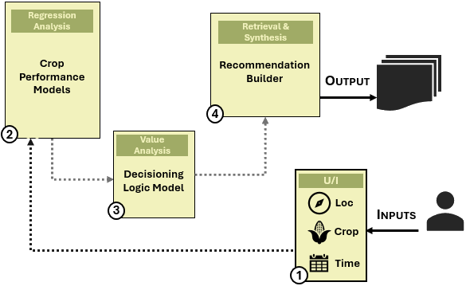

EXECUTIVE SUMMARY
PROJECT OBJECTIVE
To understand the impacts of seasonal weather on NC agricultural productivity to support climate readiness and planning for farmers and working land
APPROACH
Trained ML model to predict crop yields and production values and categorized outputs into H/M/L performing crops
Paired predictions with recommendations created using RAG-enhanced LLM and formatted results using LLM parser
PRIMARY DATA SOURCES
USDA National Agricultural Statistics Service (NASS)
North Carolina Department of Agriculture
National Integrated Drought Information System
NOAA Climate Perdition Center
KEY FINDINGS
Modeling and analyses revealed:
Model selection influenced performance for each crop
RAG and prompt engineering impacts LLM results
Influences beyond weather important to crop performance

Slide 4
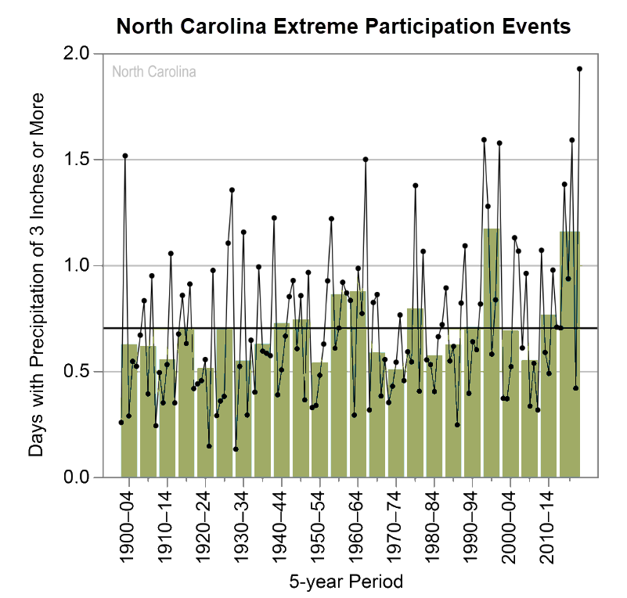
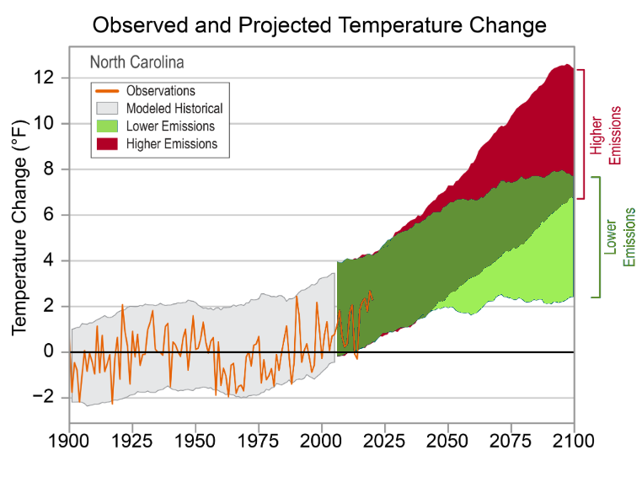
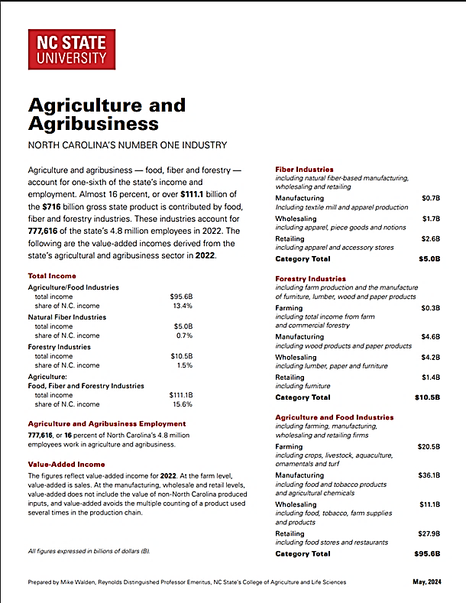

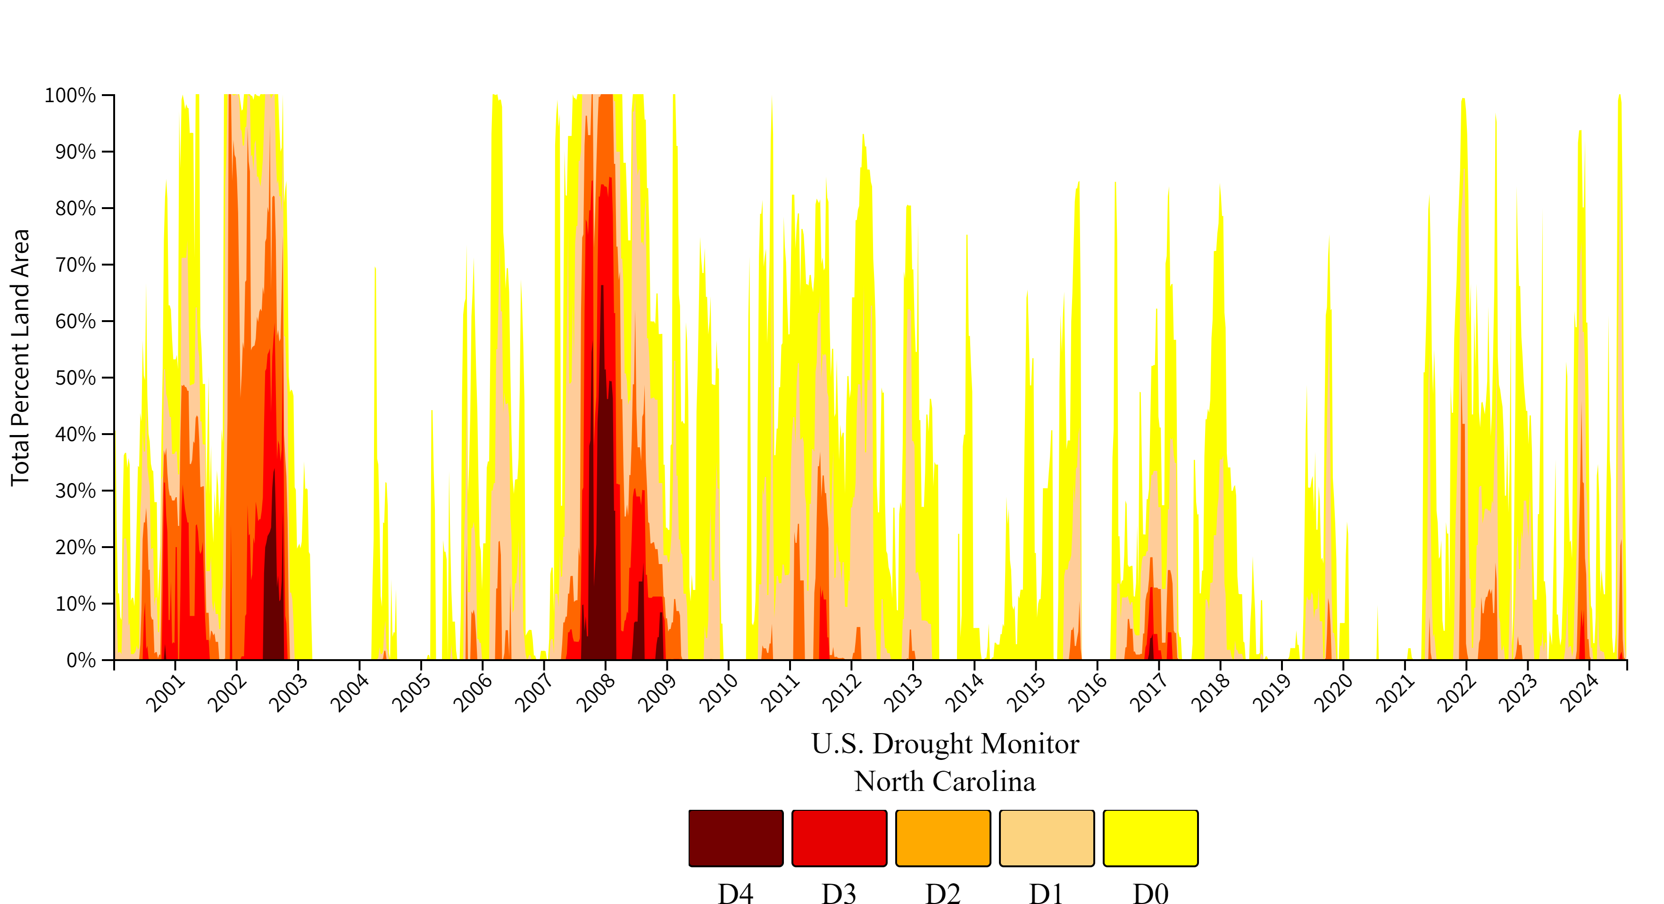

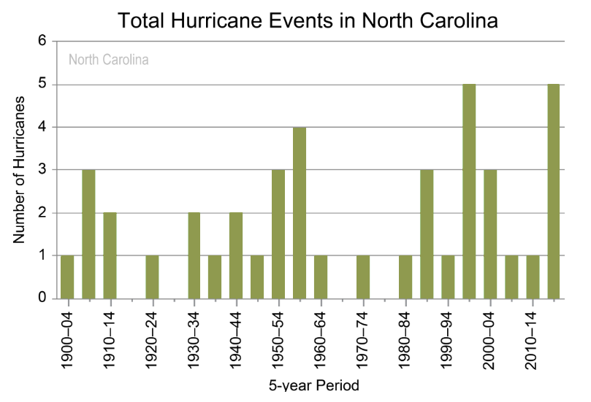


BACKGROUND
Agriculture, one of North Carolina’s most important industries, is increasingly threatened by intensifying weather and record-breaking climate events.
To protect crop yields, farmer livelihoods, and food security, urgent action is needed to help NC agriculture better prepare for and become more resilient to climate change.
FACTSHEET
$111.1
BILLION
in gross state product
Extreme Drought in North Carolina (2000-2024)
NEARLY
800,000
EMPLOYEES
across the state
Agriculture accounts for
ONE-SIXTH
of North Carolina’s
income and employment
SOURCE: NC State University, College of Agriculture and Life Sciences, NC Agriculture Industry Economic Impact, May 2024.
SOURCE: NOAA National Center for Environmental Information, State Climate Summary for North Carolina, 2022.
Notes:
Agriculture, one of North Carolinas most important industries, and presents a severe risk to global agriculture, threatening crop yields, farmer livelihoods, and food security. The extent of impacts will depend on the rate and magnitude of climate change, as well as adaptation efforts. Urgent action is needed to both mitigate climate change and help agriculture become more resilient to its effects.
- observed and projected changes (compared to the 1901–1960 average)

Slide 5

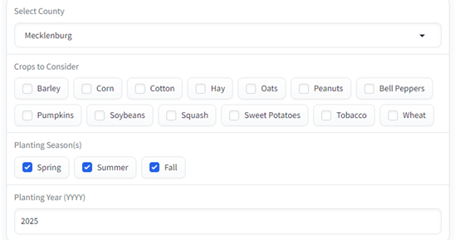

APPROACH
CORE ELEMENT DESIGN
Created Gradio user interface to capture initial inputs to be predicted
Trained linear regression model on historic weather (features) and historic crop performance (target) to predict future crop performance
Developed decision logic model to categorize crops into three performance categories.
Equipped RAG-enhanced LLM with agricultural resource material with pair classifier outputs with custom recommendations.
MODEL TRAINING
ENHANCED RAG
Agricultural
Data (Ag)
ML
Disaster Asst
Ins Programs
Risk Mitigation
Best Practices
Data By Crop Type
Acreage Planted
Yield Produced
Price per Unit
Total Value
Crop Performance
Models
Recommendation
Builder
Regression Analysis
Retrieval & Synthesis
Vector
Encoding
Weather
Data (Wx)
Data By Season
Temperature
Precipitation
CHAINING
Prompts
Parsers
4
NPL
API
Wx
Forecast
LLM
Location + Year
2
Temp + Precip
Decisioning Logic Model
Output
Critical Analysis
Predicted Yields
Predicted Unit Value
Prediction
Confidence
Recommendation
Crop Types
Barley Corn Cotton Hay Oats
Peanuts
Bell Peppers Soybeans Squash Sweet Potatoes Tobacco Wheat
Analysis Results
Customized
Crop Planning & Protection Plan
3
Decision Basis
Inputs
Crop Types
Location
KEY
Tools & Methods
Techniques
Location
Timeframe
Crop Types
1
Timeframe
Process
Models
GRADIO

Slide 6

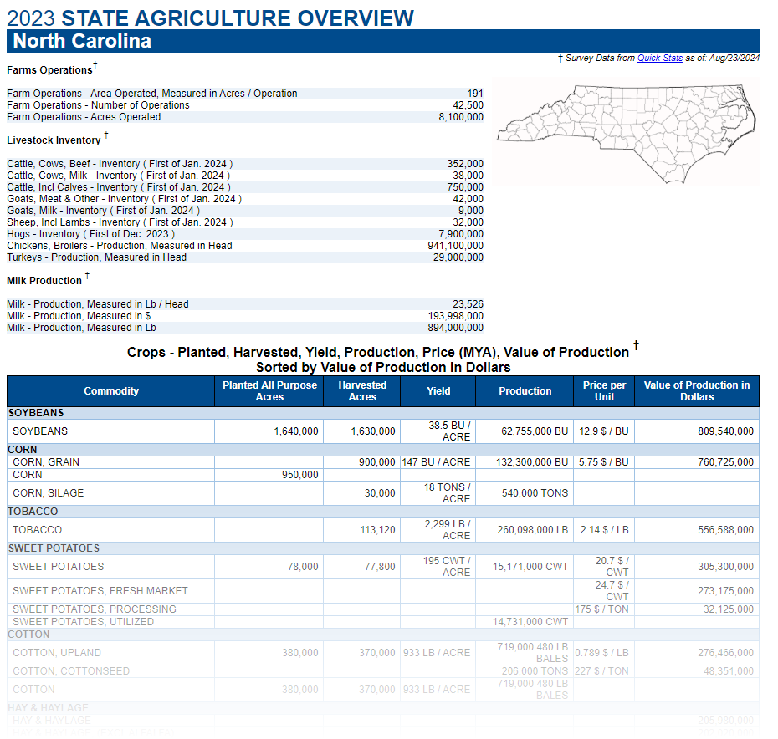





MODELING AND ANALYSIS | MACHINE LEARNING
Data Overview
Modeling Overview
MODELS
Linear Regression
SVR
Decision Tree
Random Forest
Gradient Boost
Standard Scaler
Pickle
Predicted
Unit Value per Acre
PERFORMANCE
Mean Squ Error
R² Score
Explained Var Score
Mean Abs Error
20-year Avg Unit Value per Acre
2000 - 2020
FEATURE ENG
Value
Production
Crop Types
Measure of Confidence

Slide 7
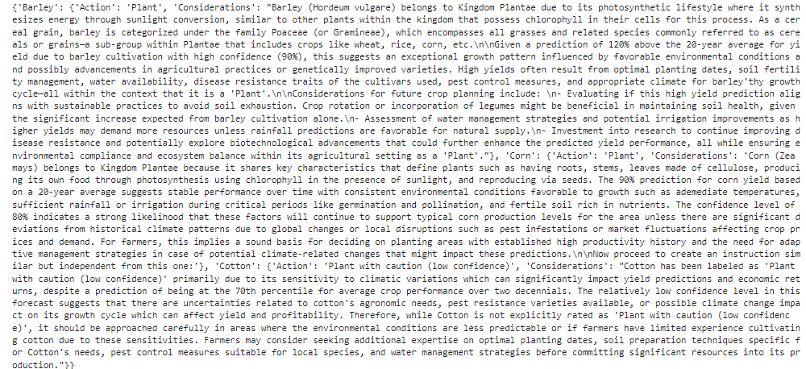
MODELING AND ANALYSIS | LARGE LANGUAGE MODEL
Predicted
20-yr avg
Confidence
Dictionary for Crops with Rationale
H-M-L
Relative Value
Value
> 85 %
Label
Plant
Plant with Caution
Do not Plant
85 – 60%
(+ confidence)
< 60%
Local LLM
Ollama (phi3 – mini)
Notes:
Phi-3 Mini
Phi-3 Mini is a 3.8B parameters, lightweight, state-of-the-art open model trained with the Phi-3 datasets that includes both synthetic data and the filtered publicly available websites data with a focus on high-quality and reasoning dense properties.
The model has underwent a post-training process that incorporates both supervised fine-tuning and direct preference optimization to ensure precise instruction adherence and robust safety measures.
When assessed against benchmarks testing common sense, language understanding, math, code, long context and logical reasoning, Phi-3 Mini-4K-Instruct showcased a robust and state-of-the-art performance among models with less than 13 billion parameters.
Phi-3.5-mini-Instruct supports a vocabulary size of up to 32064 tokens
Decision and Labeling
[Architecture]
[document loader]
Embedding model
[Retriever]
Query LLM
[RAG Information]
[type and volume of docs]
[special processing]
Local LLM: Ollama (dowload) running 'phi3:mini' model (documentation)
Hosted LLM: OpenAI (documentation) (ALTERNATIVE)
Document Loading, Embedding and Retrieval
LangChain (documentation) loads and splits documents
Unstructured (documentation) pre-processes pdf documents
OpenAI (documentation) converts documents into embeddings
ChromaDB (documentation) stores embeddings

Slide 8
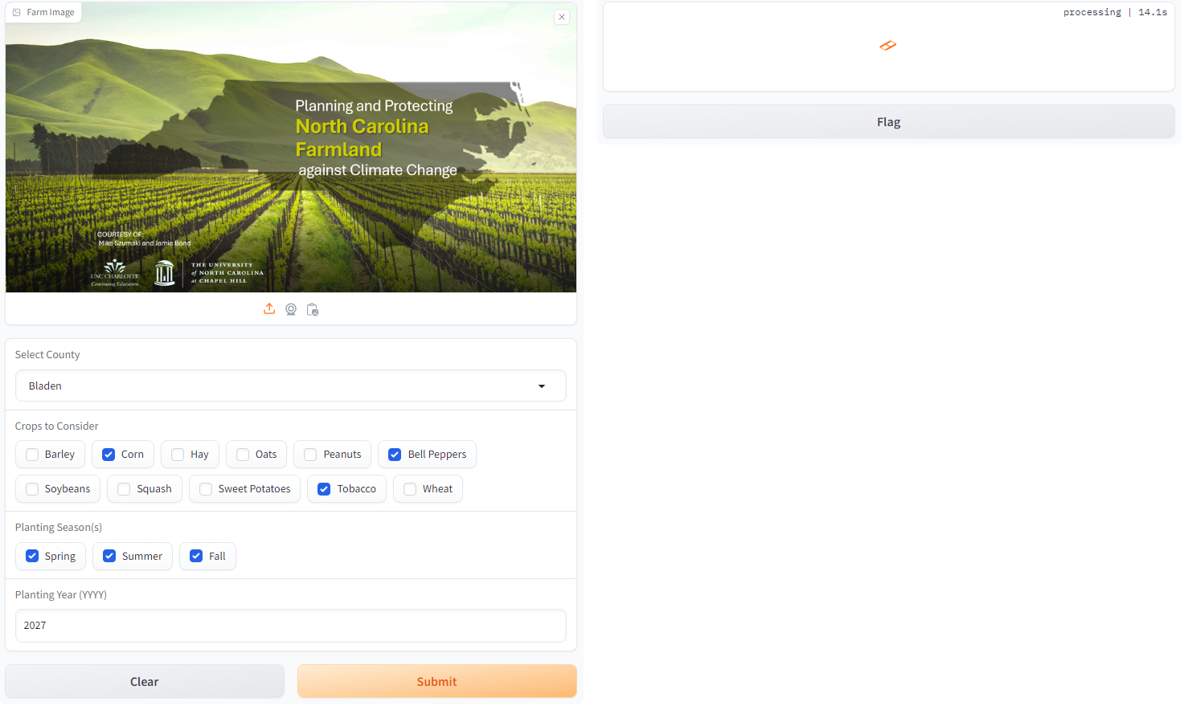
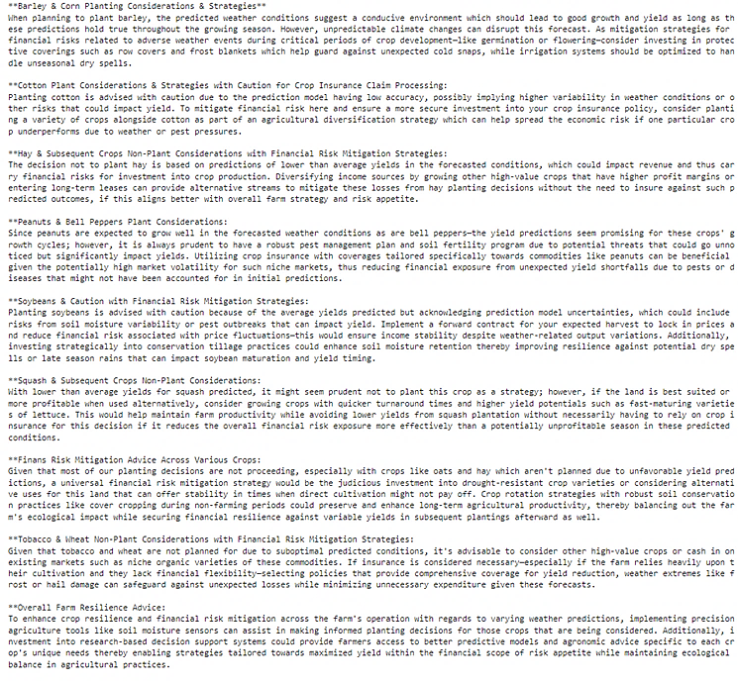
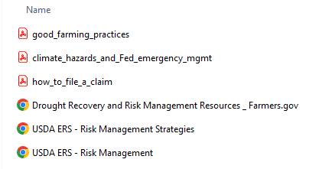
MODELING AND ANALYSIS | LARGE LANGUAGE MODEL
RAG
Embeddings
Ollama Embeddings
Prompting
LangChain
Prompt Template
Vector Store
Chroma DB
Retrieval
Local LLM
Ollama (phi3 – mini)
Notes:
Decision and Labeling
[Architecture]
[document loader]
Embedding model
[Retriever]
Query LLM
[RAG Information]
[type and volume of docs]
[special processing]
Local LLM: Ollama (dowload) running 'phi3:mini' model (documentation)
Hosted LLM: OpenAI (documentation) (ALTERNATIVE)
Document Loading, Embedding and Retrieval
LangChain (documentation) loads and splits documents
Unstructured (documentation) pre-processes pdf documents
OpenAI (documentation) converts documents into embeddings
ChromaDB (documentation) stores embeddings

Slide 9


RESULTS AND CONCLUSIONS
LIMITATIONS
Model selection influenced performance for each crop
Used different models for different crops to see model performance improvements
RAG and prompt engineering impacts LLM results
Used different models for different crops to see model performance improvements
Influences beyond weather important to crop performance
Influences of Farming Practices
Individual farming practices are likely to have a material influence on historic harvest data and are not accounted for in the model
Genetic Engineering Techniques
Model does not account for the use of seeds genetically modified for increased drought tolerance or pest resistance

Slide 10





ADDITIONAL INVESTIGATION AREAS
OTHER IMPROVEMENT OPPORTUNITIES
Geospatial Exploration
Location-specific weather and harvest data may reveal information about the impacts of topography (elevation and soil content) on crop yield
Enhanced Weather Data
Additional weather features such as humidity levels, atmospheric pressure and solar irradiance may reveal additional weather influences on yield
Infestations and Disease
Data related to crop-destroying insect populations and disease occurrences as well as pesticide use may reveal additional crop sensitives that may be modeled
Weather API integration
For demonstration purposes we simulated weather prediction data; opportunity to integrate API call to weather and climate forecasting service
Package into Docker Image
Multiple platform packages, libraries and AI tools required to create appropriate environment to run
Opportunity to containerize prediction tool in a Docker image to simplify sharing

Slide 11
REFERENCE CONTENT
GITHUB
Project Repository: github.com/mikeszumski/AgProject3
CONTRIBUTORS
Michael Szumski | @mikeszumski (prediction model design and training)
Jamie Bond | @JBondAI (interface and recommendation tool design)
DATA PROVIDERS
USDA National Agricultural Statistics Service (NASS)
North Carolina Department of Agriculture
National Integrated Drought Information System
NOAA Climate Perdition Center
ATTRIBUTIONS
USDA National Agricultural Statistics Service (NASS)
North Carolina Department of Agriculture
National Integrated Drought Information System
NOAA Climate Perdition Center

Slide 12
Planning and Protecting North Carolina Farmland against Climate Change
COURTESY OF:
Mike Szumski and Jamie Bond

Slide 13
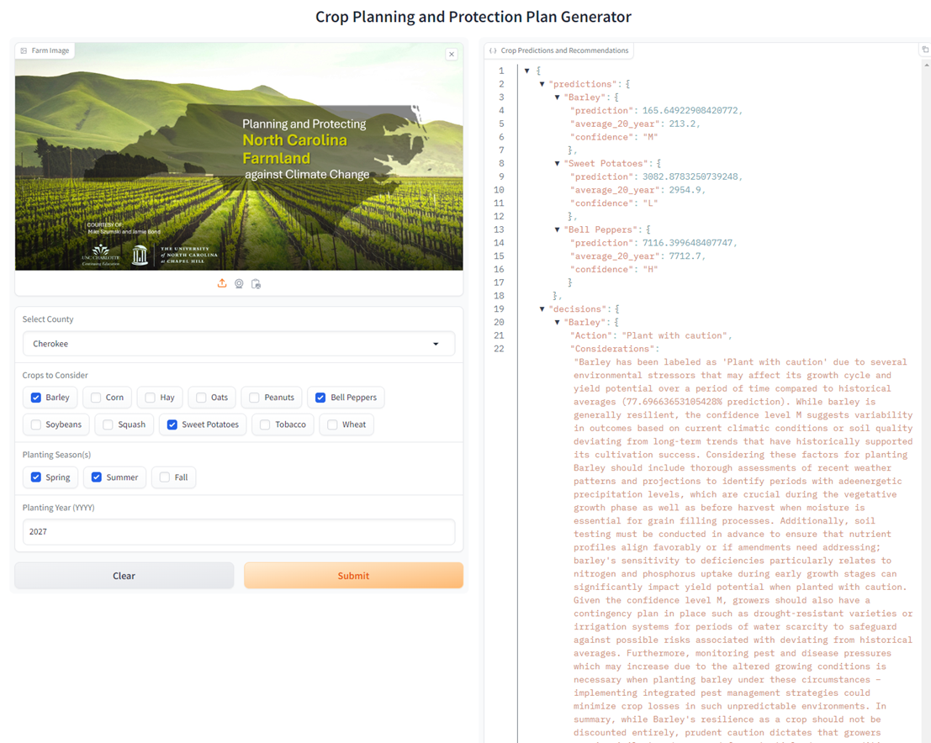

Slide 14
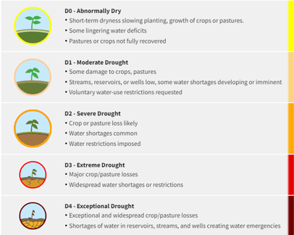
Place holder
To be deleted

Slide 15
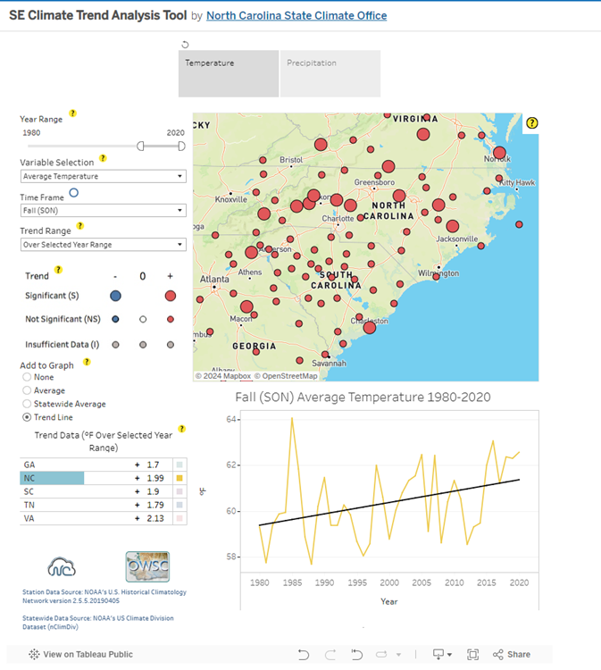
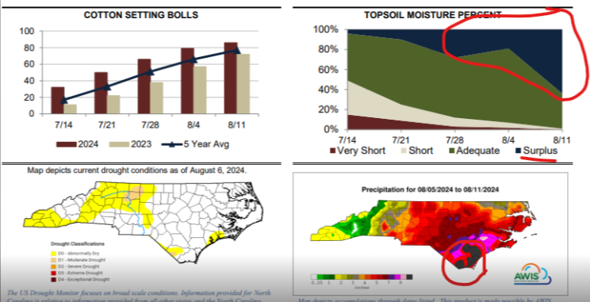
Precipitation and Temperature Data Source
To be deleted
https://public.tableau.com/app/profile/north.carolina.state.climate.office/viz/SEClimateTrendAnalysisTool/TrendAnalysisTool

Slide 16
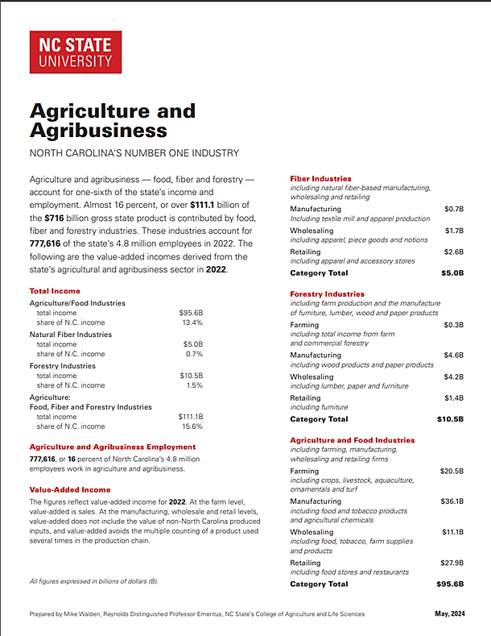
To be deleted
https://cals.ncsu.edu/agricultural-and-resource-economics/wp-content/uploads/sites/46/2017/07/AgricultureAgribusinessReport-2023-digital.pdf
https://statesummaries.ncics.org/chapter/nc/

Slide 17
APPROACH
To be deleted
Seasonal
Weather Data
(Wx)
FEATURES
Temperature
Precipitation
VECTORIZATION
CHAINING
Disaster
Assistance
Program Info
Prompts
Agricultural
Data (Ag)
TARGETS
Corn Yields
[Crop] Yields
[Crop] Yields
ML
Agriculture
Prediction
Model
Insurance
Program Info
Parsers
Harvest Prediction
Model
MODEL TRAINING
LLM
DA
Decisioning & Recommendation Model
Crop
Types
HARVEST
YIELDS
Net Benefit
PROFITABILITY
SEED COSTS
Wx
Forecast
CONFIDENCE LEVELS
COMMODITY PRICING
Financial Prediction
Model
TARGETS
Seed Costs
Commodity Pricing
Farm Protection Plan
Financial
Trends ($)
MODEL TRAINING
Notes:
Model takes precipitation and temperature
Find relationships plant advisor
Conditions

Slide 18




APPROACH
To be deleted
Crop Performance
Models
Regression Analysis
Recommendation
Builder
Retrieval & Synthesis
Output
4
2
Decisioning Logic Model
Value Analysis
U/I
Loc
3
Inputs
Crop
Time
1

Slide 19
MODELING AND ANALYSIS | CROP PREDICTION MODEL
Added some placeholder content for consideration
Data Pipeline and Wrap Around Code
[Data manipulations between user input and model input]
weather forecast access
point
[Data manipulations between model output and next component (decision logic model)]
point
point
Objective
For each NC crop type, predict crop yields, crop values, confidence levels given a users [input 1, input 2 ..]
ML Model (Supervised Learning)
Model Selection
[Model selected]
Model Training
[training data, features and targets]
[notable data manipulation and /or observations]
[model scoring and initial performance]
Model Optimization
[optimization strategies applied]
[final performance]
ML
Crop Performance
Models
Regression Analysis
2
Notes:
From code
import pandas as pd
import matplotlib.pyplot as plt
from sklearn.preprocessing import StandardScaler, MinMaxScaler
from sklearn.cluster import KMeans
from sklearn.decomposition import PCA
from sklearn.model_selection import train_test_split
from sklearn.linear_model import LogisticRegression
#from sklearn.neighbors import KNeighborsClassifier
#from sklearn.svm import SVC
#from sklearn.tree import DecisionTreeClassifier
#from sklearn.ensemble import RandomForestClassifier
#from sklearn.ensemble import GradientBoostingClassifier
#from sklearn.metrics import classification_report
from sklearn.model_selection import cross_val_score
from sklearn.model_selection import GridSearchCV
from sklearn.model_selection import StratifiedKFold
from sklearn.linear_model import LinearRegression
from sklearn.svm import SVR
from sklearn.tree import DecisionTreeRegressor
from sklearn.ensemble import RandomForestRegressor
from sklearn.ensemble import GradientBoostingRegressor
from sklearn.metrics import mean_squared_error, r2_score
from sklearn.model_selection import GridSearchCV

Slide 20
MODELING AND ANALYSIS | DECISION LOGIC MODEL
Assumes input will be a list of list of yields (%), list of production values ($/acre) and list of confidence values (float)
Justification Narrative
[Tools]
[prompts]
[parsers]
[LLM]
[Issues/Learnings]
[point]
[point]
Objective
Based on predicted yield, production value and confidence level of prediction, label each crop as a ‘High’, ‘Moderate’, or ‘Low’ performing and generate justification narrative for determination.
Crop Labeling
[Method for categorizing]
[data description]
[tools/techniques]
[Considerations]
[likelihood of upside/downside]
[confidence of model and weather predictions]
[logic model – translation into code]
Decisioning Logic Model
Critical Analysis
3

Slide 21
MODELING AND ANALYSIS | RECOMMENDATION BUILDER
Assumes input is a dataframe with values and text
Recommendation Narrative
[Tools]
[prompts]
[parsers]
[LLM]
[Issues/Learnings]
[point]
[point]
Objective
Based on the determination of crop performances and associated justification, generates recommendation narrative for each crop and why the recommendation has been made (justification). Supplement final recommendations with relevant considerations and risk mitigation information retrieved from RAG.
RAG-Enhanced LLM
[Architecture]
[document loader]
Embedding model
[Retriever]
Query LLM
[RAG Information]
[type and volume of docs]
[special processing]
Recommendation
Builder
Retrieval & Synthesis
4
Notes:
Natural Lanugage Processing
Local LLM: Ollama (dowload) running 'phi3:mini' model (documentation)
Hosted LLM: OpenAI (documentation) (ALTERNATIVE)
Document Loading, Embedding and Retrieval
LangChain (documentation) loads and splits documents
Unstructured (documentation) pre-processes pdf documents
OpenAI (documentation) converts documents into embeddings
ChromaDB (documentation) stores embeddings

